Slide 1

“Freedom, Faith, Love, and Truth”
5:1 – 12
Week 11
30 March 2022

Slide 2

Galatians Overview
In our last lesson, Paul made his final argument to show the difference between law and promise. He reminded the Jews that Abraham had two sons: Ishmael the child of his slave woman Hagar and Isaac the child of his wife Sarah. Paul stated that these two births had allegorical implications and represented two different covenants.
Hagar, the bondwoman represented the covenant given at Mt. Sinai, corresponded to physical Jerusalem, and the bondage of those under the Law.
Sarah, the wife represented the new covenant, corresponded to the heavenly Jerusalem, and the freedom to all who accept it. Paul concluded his defense of the gospel of justification by faith in Christ by proclaiming that those in Christ are not of the bondwoman but of the free.

Slide 3
Galatians Overview
In chapter five, Paul reaches the climax of this epistle, by stating what can properly be called the theme of the letter:
“Stand fast therefore in the liberty by which Christ has made us free, and do not be entangled again with a yoke of bondage.”
Then Paul follows with dire warnings about the consequences of seeking to be circumcised and justified by the Law. He then reminds the Galatians that the hope of righteousness is for those who through the Spirit eagerly wait for it with a faith working through love (5:1-5).

Slide 4
Galatians Overview
The next few verses continue with warnings about allowing others to hinder their progress, with Paul's harshest words reserved for those trying to impose circumcision (5:6-7).
Paul warns them that a little of anything will effect the whole of everything. Paul asks that if he was preaching circumcision then why was he under persecution? Yet those troubling them about circumcision should themselves be “cut off” (5:8-12).

Slide 5

“Freedom, Faith, Love, and Truth”

Slide 6
Galatians Introduction
In this letter, Paul openly exposes and boldly assails the false teaching of legalism. Here in the first twelve verses of chapter 5, starting in verse one (5:1), Paul introduces a contrast he develops through verse twelve (5:12). Contrasting a religion based on the act of circumcision (law) versus new life found in Jesus Christ alone (grace).
Because these two ways of life—law and grace– are mutually exclusive, Paul writes with great passion to the Galatians, “Get off the fence!”

Slide 7
Galatians 5:1
¹It is for freedom that Christ has set us free. Stand firm, then, and do not let yourselves be burdened again by a yoke of slavery.

Slide 8
Galatians 5:1
Paul begins with an assertion: “It was for freedom that Christ set us free.” It sounds redundant, doesn’t it? Paul uses simple, straightforward language to keep his main point clear. Christ set us free so we could bask in the benefits of His salvation, and live out our freedom in Christ without guilt or condemnation.
This freedom offers us a new lifestyle. Now we have the ability to live by the Spirit’s power. We are free to obey God and do His will joyfully. We can love and serve others. We can enter into the Lord’s presence through prayer, and we can experiencing a close, personal relationship with Him. Before salvation, we couldn’t take advantage of any of these benefits. We were penniless, pathetic slaves to sin. Now, we can enjoy these benefits to the fullest - Christ has set us free.

Slide 9
Galatians 5:1
Paul punctuates this declaration of liberty with a command: “Therefore keep standing firm and do not be subject again to a yoke of slavery.” Similar to the yoke used to tie animals to farm equipment or wagons, a “yoke of slavery” was any device used to tie slaves to each other or to limit their movements in some way.
The yoke could be made of wood or metal, but either way its function was the same—to force a slave to submit, to remain in prescribed bounds, and to carry out the work assigned to him or her.

Slide 10
Galatians 5:1
The yoke of legalism restricts us by convincing us that an inflexible list of “thou shalts” and “thou shalt nots” is the safest way to remain pure and acceptable to God. Believers caught in the yoke of legalism always search for partners to share the burden with them, recruiting more converts to the cause of slavery.
The more legalist attached to the chain gang, the better—that’s their mentality. Yet Paul’s exhortation breaks the yoke before it catches us by the neck: Don’t surrender your freedom; defend it with your life.

Slide 11
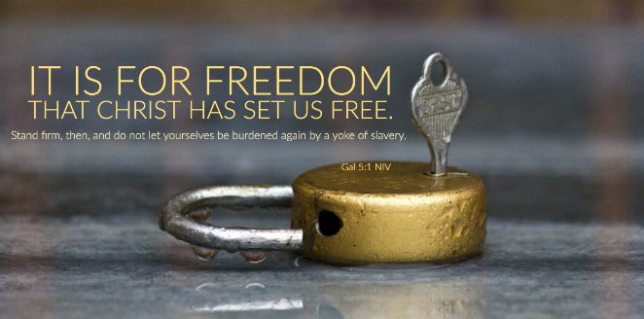

Slide 12
Galatians 5:2 – 6
²Mark my words! I, Paul, tell you that if you let yourselves be circumcised, Christ will be of no value to you at all. ³Again I declare to every man who lets himself be circumcised that he is obligated to obey the whole law. ⁴You who are trying to be justified by the law have been alienated from Christ; you have fallen away from grace. ⁵For through the Spirit we eagerly await by faith the righteousness for which we hope. ⁶For in Christ Jesus neither circumcision nor uncircumcision has any value. The only thing that counts is faith expressing itself through love.

Slide 13
Galatians 5:2 – 6
Paul now turns his attention to those who have begun to embrace legalism. Having been duped by the deceivers, many have let that cruel yoke of slavery slip gently around their necks. Paul exhorts the Galatians to reject its flawed legalism and return to a life of grace before the Judaizers screw the bolts tight and bind them in permanent chains.
Those Galatians who had received circumcision as a sign of their covenant commitment to keep the Law were snubbing the very One who had freed them from the Law: Jesus Christ (5:2). When Paul speaks of circumcision, we need to understand that he’s using this Jewish ritual to point to the whole of the Judaizers’ lifestyle.

Slide 14
Galatians 5:2 – 6
Just as baptism was the sign of dying to the Law and being raised to a new life of freedom, circumcision was the sign of submission to the Law, essentially reversing and undoing the sign of baptism!
Paul delineates three consequences of entering into the lifestyle of legalism through the sign of circumcision:
~ “Christ will be of no benefit to you” (5:2).
~ You will be obligated “to keep the whole Law” (5:3).
~ You will be alienated from Christ’s grace (5:4).

Slide 15
Galatians 5:2 – 6
FIRST – by receiving circumcision, the Galatians would have been saying that Jesus’ sacrifice on the cross was insufficient either to save them or to sanctify them (5:2).
They would have been trying to add to His payment for sin. By accepting the idea of righteousness by their own works, they were rejecting the work of Christ that provides righteousness by faith.
From a legalistic point of view, Christ might as well not have come at all. By turning to the Law, they were turning from Christ.

Slide 16
Galatians 5:2 – 6
SECOND – by receiving circumcision, the Galatians placed themselves under a covenant commitment to keep the whole Law (5:3).
Just as wedding vows place a person into a covenant relationship as a husband or wife, circumcision obligates people to follow the lifestyle it initiates.
The Galatians couldn’t choose just one small part of the Law. Once they chose any of it, they had really chosen all of it.

Slide 17
Galatians 5:2 – 6
THIRD – by receiving circumcision, the Galatians severed themselves from the grace of Christ (5:4).
Once the Galatians chose the Law as their savior and lord, they cut their ties to Christ as Savior and Lord. Does this mean that the Galatians actually lost the eternal life they had received when they believed? Not at all! Paul is now discussing law and grace as two diametrically opposed rules of life.
Notice that Paul doesn’t say they had fallen from salvation. When somebody chooses the legalistic lifestyle, they’ve fallen from the lifestyle of grace and all of its benefits.

Slide 18
Galatians 5:2 – 6
They are seeking to be justified before God and men by their works done in the power of the flesh—their own abilities, unaided by grace—rather than by grace through faith by the power of the Holy Spirit. In short, when we take up the torch of the flesh, we scorch the work of the Spirit.
What are some difference between living in the flesh and living by faith? FIRST, our approach to personal righteousness is different. When we live according to our own merit, we believe that the burden for holiness rests solely upon our shoulders.
As a result, we feel compelled to work by the sweat of our brow to achieve that righteousness. But when we live by faith, we trust that our righteousness is secure in Christ.

Slide 19
Galatians 5:2 – 6
That the Spirit is working daily to conform us to His image, and that perfect holiness will come only when Christ glorifies us (5:5).
A SECOND major difference between living in the flesh and living by faith is that our lives become characterized not by laws, but by love. The essential fuel for a flesh-oriented life is work; for a Christ-centered life, it’s faith expressing itself in love (5:6).
James similarly emphasizes that true faith manifests itself through good deeds done out of genuine concern for others (Jam 1:27; 2:14-17). Though faith and law are mutually exclusive, faith and love are inseparable essentials in a truly grace-based, Spirit-empowered life.

Slide 20
Galatians 5:7 – 12
⁷You were running a good race. Who cut in on you to keep you from obeying the truth? ⁸That kind of persuasion does not come from the one who calls you. ⁹“A little yeast works through the whole batch of dough.” ¹⁰I am confident in the Lord that you will take no other view. The one who is throwing you into confusion, whoever that may be, will have to pay the penalty. ¹¹Brothers and sisters, if I am still preaching circumcision, why am I still being persecuted? In that case the offense of the cross has been abolished. ¹²As for those agitators, I wish they would go the whole way and emasculate themselves!

Slide 21
Galatians 5:7 – 12
Paul’s intense love and sincere concern for the tripped-up Galatian believers shines in 5:7-12. Here he expresses his optimistic hope for his hearers while coming down hard on those who have led them astray.
He begins with a word picture taken from the world of athletics. At the start of the marathon of the Christian life, they “were running well” (5:7). But along the way they had been hindered from fully “obeying the truth,” that is, living in conformity with the truth of the gospel of grace through faith.
Along the path, somebody had interrupted their stride, causing them to stumble. The Judaizers had placed an obstacle in the path, tripped them up, and waylaid their progress.

Slide 22
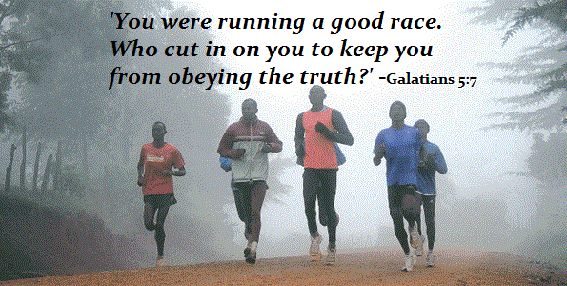

Slide 23
Galatians 5:7 – 12
Bruised and battered, they were leaving the track and strapping heavy weights of the Law around their ankles and chests. Paul wanted them to realize the egregious error they were making. Instead of running free toward the crown of life, they were panting laboriously on the treadmill of fruitless endeavor.
God had originally called the Galatians by grace (1:6). So, logically, this new change in direction was not from Him (5:8). Those who had added this alien teaching of legalism to the original pure gospel of grace were in the process of destroying the entire message delivered by Christ’s apostle. Paul likens this infection of law to the effects of leaven on a lump on dough (5:9).

Slide 24
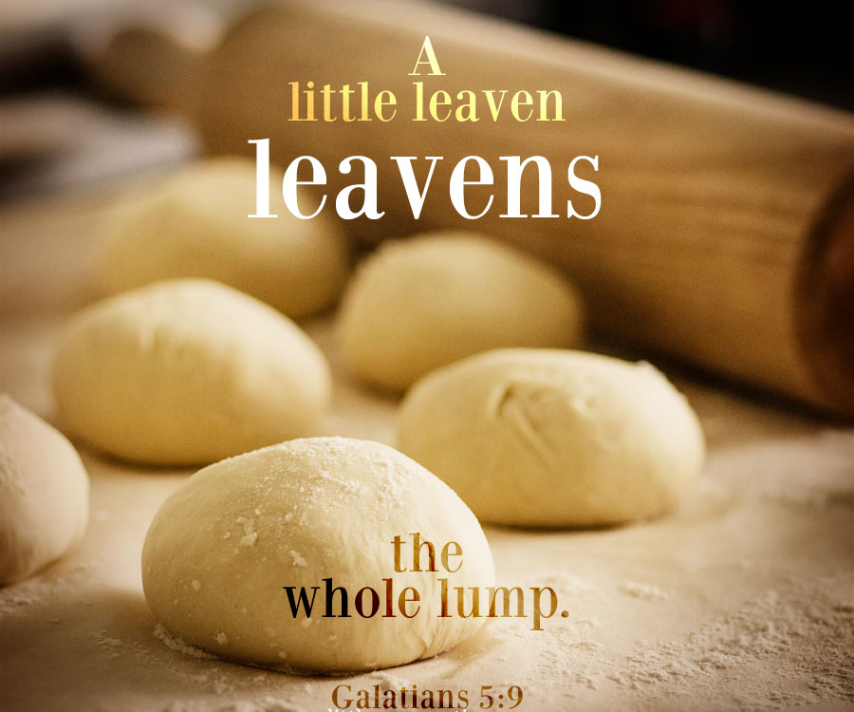

Slide 25
Galatians 5:7 – 12
Just as a speck of leaven will eventually multiply and spread throughout the whole lump, the false teaching threatened to completely undo the faith the Galatians had once received.
But all hope was not lost! Paul expressed his confidence that the Galatians would remove the impediments from their path, extract the leaven from their dough, and returning to a lifestyle characterized by the priceless grace of God (5:10). He believed that most would shun the legalists after taking his concerns to heart.
For those believers who were still unconvinced, Paul’s next words about the destiny of the bothersome legalists might finally sway them: The Judaizers would be judged.

Slide 26
Galatians 5:7 – 12
Those who live by the Law will be condemned by the Law (Romans 3:20). Legalism leads to judgment.
We don’t know if this is the kind of judgment one experience in this life or judgment before the throne of Christ. It could be both. If some of the legalists happened to be believers who had gone astray, they would at least suffer loss of reward at the judgment seat of Christ (1Cor 3:15).
Why? Because though they presumed to be teachers of the Law, they did not understand what they were teaching (1Tim 1:7).

Slide 27
Galatians 5:7 – 12
James pronounces a sobering warning that should cause any self-proclaimed teacher to pause: “Let not many of you become teachers, my brethren, knowing that as such we will incur a stricter judgment” (James 3:1). In any case, no matter who these false teachers were or what their spiritual state was, God would bring His discipline in His own time and in His own manner.
Finally, Paul answers the hypothetical question, “What if I were to preach circumcision? Me, the apostle who preached grace? Is there any way I could fit that into my gospel of salvation by grace through faith?” We do know that on special occasions Paul allowed for the circumcision of Christians for cultural reasons, as he would grant for Timothy because of the Jews (Acts 16:1-3).

Slide 28
Galatians 5:7 – 12
This fits in with Paul’s ministry strategy of becoming “as a Jew” for the Jews, in order to “win Jews” (1Cor 9:20). Paul wasn’t preaching circumcision but removing a cultural obstacle in order to make way for the preaching of grace. However, it may be that his critics pointed to this as a contradiction between Paul’s preaching and practice—or as evidence that Paul did in fact support their position on circumcision.
But Paul makes it clear that even these allowances of circumcision for cultural reasons did not mean that he was “preach[ing] circumcision” (5:11). If this were the case, then why all the controversy? The gospel of grace offends human nature because we stoke our pride by believing we can work for anything we want.

Slide 29
Galatians 5:7 – 12
Anyone who douses that pride with a message of dependence on Christ will catch a white-hot blast of arrogant rage. The fact that Paul was suffering at the hands of the Judaizers proved that he was not on their side. It proved that his message was indeed a gospel of liberty.
Paul’s intense love for the Galatians and zeal for the truth is demonstrated most vividly in 5:12. With an outburst that could offend the squeamish, he announces, “I wish that those who are troubling you would even mutilate themselves.” What a statement! Paul says he’s so fed up with the legalists’ destructive requirement of circumcision that he wishes they would go all the way and emasculate or mutilate themselves, putting an end to their madness.

Slide 30
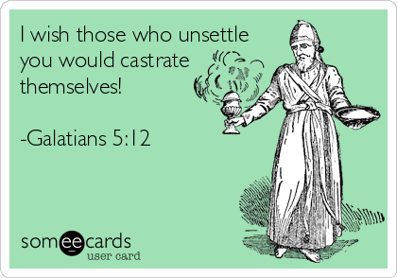
(NRSV)

Slide 31
Galatians 5:7 – 12
This may sound like an extreme—even mean-spirited—reaction to the Judaizers. But if we were as concerned about defending the gospel of grace as Paul was, we too would be guarding it with every rhetorical device we could think of.
We would lock our freedom in the deepest bunker of our hearts, vigorously defending it against the attacks of false teachers.
Paul uses some strong, blunt, and even painful language in this section because he rightly sees that our freedom in Christ is worth fighting for. We dare not let it slip away or allow anybody to snatch it from us.

Slide 32
Galatians 5:7 – 12
Consider the following questions that will help us evaluate our own zeal for freedom:
1] How highly do I value my freedom in Christ? Does it mean more to me than money, home, family, friends? Do I compromise on Christian freedom in order to fit in at church. Do I succumb to the slavery of legalism, submitting to human rules and regulations?
2] How strongly do I resist having my freedom stolen? Do I submit to rules that strap me down spiritually, stopping or even reversing my Christian growth? Do I actually check the bases for the accepted Christian norms fed to me at church, at home, or from other sources? When was the last time I took a firm stand against legalism?

Slide 33
Galatians 5:7 – 12
Consider the following questions that will help us evaluate our own zeal for freedom:
3] How tolerant am I of other Christians and their exercise of freedom? Do I insist that fellow believers adopt my personal preferences on nonessential matters? Or do I flaunt my freedom in front of those with weaker consciences?
Once we’ve thoroughly examined our zeal for freedom, we need to exercise it! Every day is a new opportunity to live and breathe the liberty Christ has provided. Don’t lose your freedom. Don’t give it away like the Galatians did. Don’t fall under the influence of legalism. Let grace be your way of life.

Slide 34

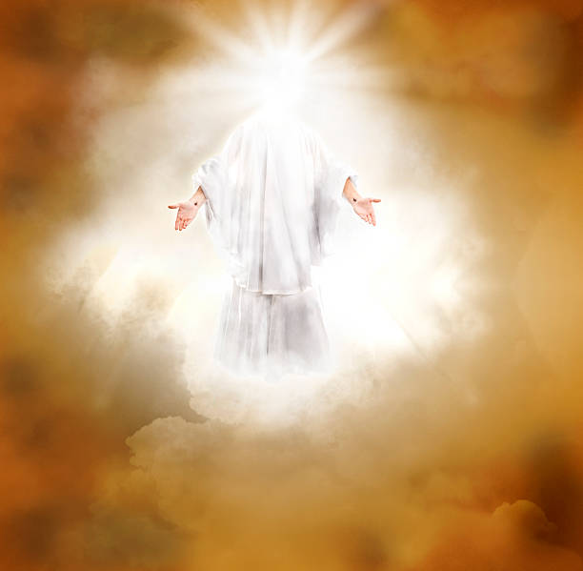

Slide 35
NEXT CLASS – 6 April 2022
Book of Galatians
Before next class, read the below verses in the KJV and the NIV, plus one additional versions of the Bible, i.e., NRSV, NLT, NKJV, etc …
Chapter 5:13 – 25
“Leaning to Walk in Freedom”
EBC Website for Handouts
https://bit.ly/surveyofpaulineepistles

